Slide 1
Drug Discovery Process:
Target Identification and Validation
Nancy Thornberry
Worldwide Basic Head, Diabetes & Obesity, Rahway,NJ
Johan Auwerx
Professor EPFL

Slide 2
Stages of Small Molecule Drug Discovery
Target
ID
Target
Validation
Hit
ID
Hit to
Lead
Lead
Opt
PCC
Industry-wide trend to adopting more defined stages for Preclinical Candidate Discovery
  Hit to Lead
    Small Medicinal Chemistry team
  Lead Optimization
    Full scale application of Medicinal Chemistry, Drug Metabolism
    Accrues additional resources from e.g., PR&D, Safety Assessment
Each stage is described by acquisition of specific data that enables and justifies transition to the next step
  Each stage offers an opportunity for critical assessment of programs
Notes:
Although MRL conforms in many ways to this model, we have not been quite as explicit in thinking about these stages, especially in terms of the management of project flow across the organization.
There are some good reasons to think of these more discretely particularly in that Each stage is described….
Transitions between these stages provide a natural cue for reflection and criticism of the likelihood of success at the next stage and ideally POS all the way through to clinical POC

Slide 3
Target Identification and Validation in Drug Discovery
Target
ID
Target
Validation
Hit
ID
Hit to
Lead
Lead
Opt
PCC
Major emphasis at MRL in past several years on use of new technologies for target identification and validation to identify proprietary targets
Acquisition of Sirna in 2007 reinforced this commitment
Extensive use of mouse and human genetics through academic collaborations

Slide 4
New Target Identification: Sources
Pathway /
Network Analysis
Mouse
Genetics
Human
genetics
External Information / Licensing
Collaborations
GEMMs
RNAi
in vitro
in vivo

Slide 5
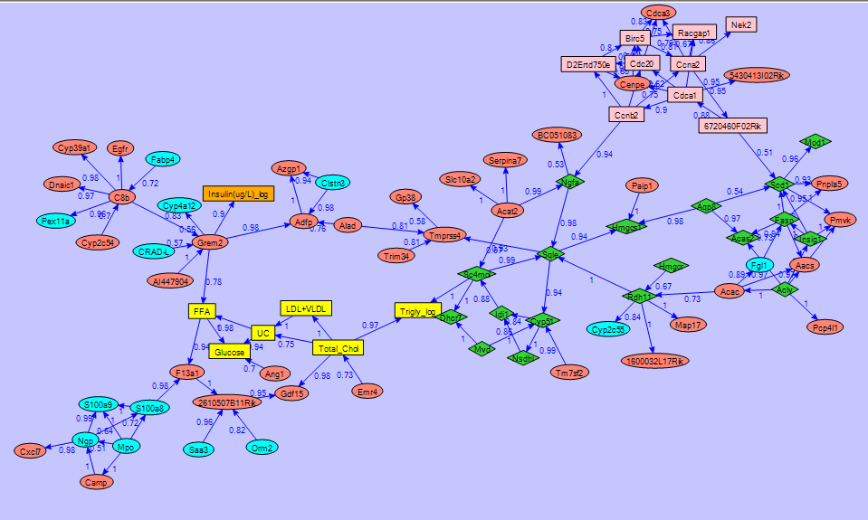
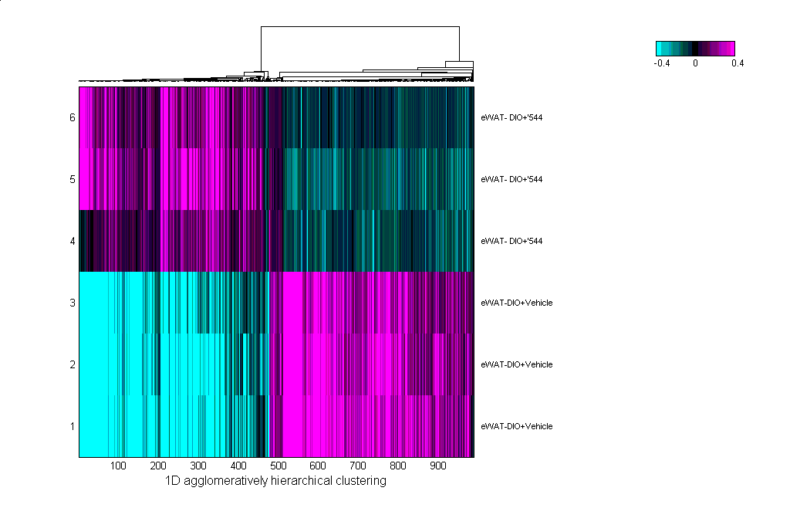


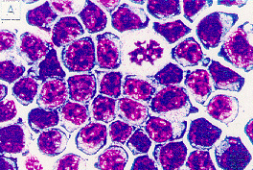
Integration of Different Datasets is Key to Target Identification and Prioritization
Genetic Networks
Gene expression data
Genetic Studies
(Mouse & Human)
Other relevant data
siRNA/ KO/
compound

Slide 6
Target ID & Validation: Example Research Operating Plan
Literature / External Information
Mouse Genetics /
e.g. BXDs
Human Genetics /
Profiling
RNAi
Cell based assays
Pathway Mining
Networks
“High Confidence” Candidate Targets
Genetics
KO
Viral vectors
ASO
siRNA
Pharmacology
Exploratory chem
Peptides
antibodies
Rodent POC
“Validated” Targets
PCC candidates for lead optimization

Slide 7
New Target Identification

Slide 8
New Target Identification: Sources
Pathway /
Network Analysis
Mouse
Genetics
Human
genetics
External Information / Licensing
Collaborations
GEMMs
RNAi
in vitro
in vivo

Slide 9
New Target Identification: External Information Example: Identification of DPP-4 as a Target for Diabetes
DPP-4 is the target of Januvia/Sitagliptin
Information available prior to program initiation:
  GLP-1 well validated as a treatment for Type 2 Diabetes in humans
  DPP-4 confirmed to be primary enzyme involved in proteolytic inactivation of GLP-1
  DPP-4 inhibitors from Novartis and Probiodrug shown to stabilize GLP-1, and lower glucose in rodents
Novartis DPP728
K_{i} = 5 nM
(1st generation compound)
Probiodrug P32/98
K_{i} = 220 nM

Slide 10
External Information: GLP-1 Lowers Fasting and Post-Prandial Glucose in Type 2 DM
Rachman et al., Diabetologia 40, 205-211 (1997)
16
Saline
14
GLP-1
Control
12
10
Glucose (mmol/l)
8
6
4
2
Breakfast
Lunch
Snack
0
22.00
24.00
02.00
04.00
06.00
08.00
10.00
12.00
14.00
16.00
Clock Time (h)

Slide 11
External Information: Studies with DPP-4 Deficient Mice
Marguet et al. PNAS 97, 6874-6879 (2000)
Increased Active GLP-1
Improved Glucose Tolerance
400
8
WT
*
350
*
300
DPP-4 -/-
6
*
, pM
250
Blood Glucose (mg/dl)
(7-36)
4
200
GLP-1
150
2
100
0
50
WT
-/-
0
20
40
60
80
100
120
Time (min)

Slide 12
Well Validated Pathways in Humans Should be Thoroughly Mined for Targets
Example: Approaches to the GLP-1 Pathway
Small molecule
agonist
DPP-4 resistant
GLP-1 mimetics
GLP-1 releasers
Combinations
with DPP-4 inhibitors (e.g. Janumet)
GLP-1R
GLP-1
GLP-1R
DPP-4
inhibitor
inactive GLP-1
GLP-1 pathway mining
by microarray and RNAi

Slide 13
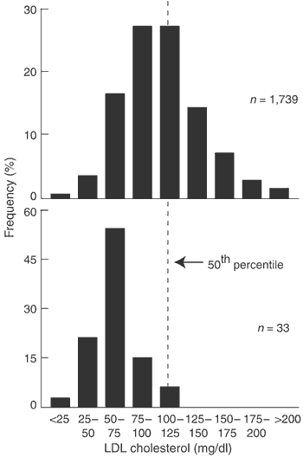
New Target Identification: External Information
Example: PCSK9 as a target for LDL-lowering
Dallas Heart Study
Dallas Heart Study identified PCSK9 mutations common in African Americans. Heterozygotes have 40% lower LDL cholesterol
A human with no PCSK9 was identified with an LDL cholesterol level of 14 mg/dl
Control
PCSK9 heterozygous mutants
Cohen et al. Nature Genetics 37:161

Slide 14
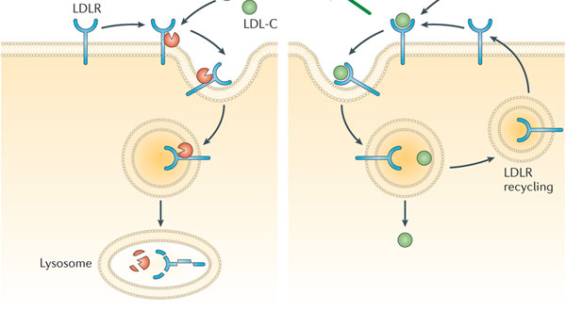
Targeting PCSK9 to lower cholesterol by a mAb (Regeneron)
PCSK9

Slide 15
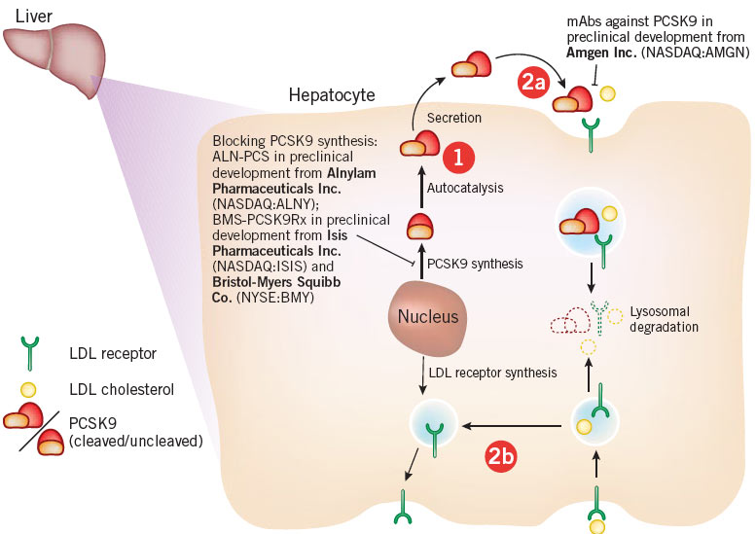
Targeting PCSK9 to lower cholesterol by a RNA interference (Alnylam)

Slide 16
New Target Identification: Sources
Pathway /
Network Analysis
Mouse
Genetics
Human
genetics
External Information / Licensing
Collaborations
GEMMs
RNAi
in vitro
in vivo

Slide 17
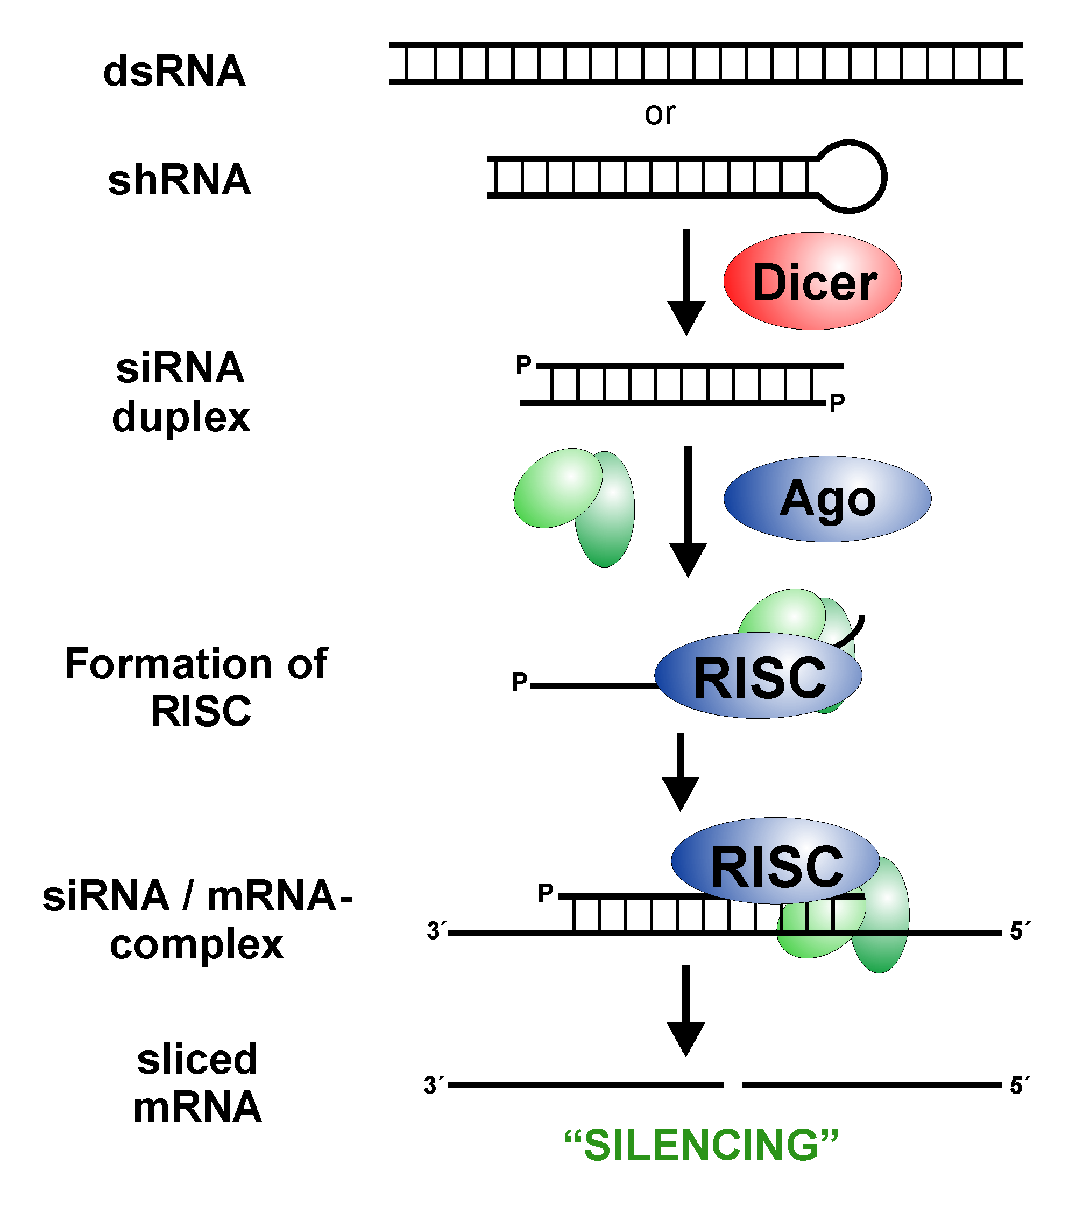
New Target Identification: RNA Interference (RNAi)
Innate Gene Silencing Mechanism
Degradation of any mRNA
Potential for high specificity
More potent than antisense
Long persistence
Catalytic mechanism
Evolutionary conserved

Slide 18
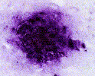
RNAi Screens in Alzheimers: Processing of Amyloid Precursor Protein (APP) by Secretases
β-secretase
γ-secretase
APP
sAPPβ
Aβ40
Aβ42
Amyloid Plaques

Slide 19
New Target Identification: Sources
Pathway /
Network Analysis
Mouse
Genetics
Human
genetics
External Information / Licensing
Collaborations
GEMMs
RNAi
in vitro
in vivo

Slide 20
Target Identification: Mouse Genetics
Example: MegaX
F0
X
Disease Phenotype
(n>20)
Obesity
resistant
Obesity
susceptible
F1
Trait Gene Correlations
cQTL’s
eQTL’s
F2
Genotype
(n=1500)
Gene Expression
(n=25,000)
Each F2 mouse is genotyped
Each F2 mouse is phenotyped (fat pad mass, insulin, aortic lesion, etc)
Tissues such as adipose, liver, muscle and brain are harvested and gene expression profiled
Identify causal genes associated with clinical traits to identify key drivers of disease

Slide 21
MegaX Example: GPR105, a Target for Obesity
Validation with Antisense
Body Weight
GPR105 mRNA levels
control antisense
40
vehicle
35
30
25
20
GPR105 antisense
15
10
5
0
0
1
2
3
4
5
weeks
Significant resistance to wt gain
Reduced fat mass
No effect on food intake
Reduced insulin levels
>85 % knockdown of GPR105

Slide 22
New Target Identification: Sources
Pathway /
Network Analysis
Mouse
Genetics
Human
genetics
External Information / Licensing
Collaborations
GEMMs
RNAi
in vitro
in vivo

Slide 23
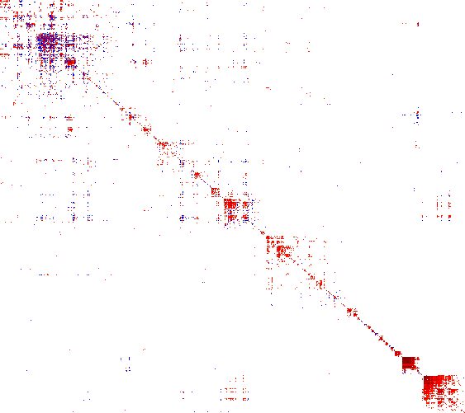
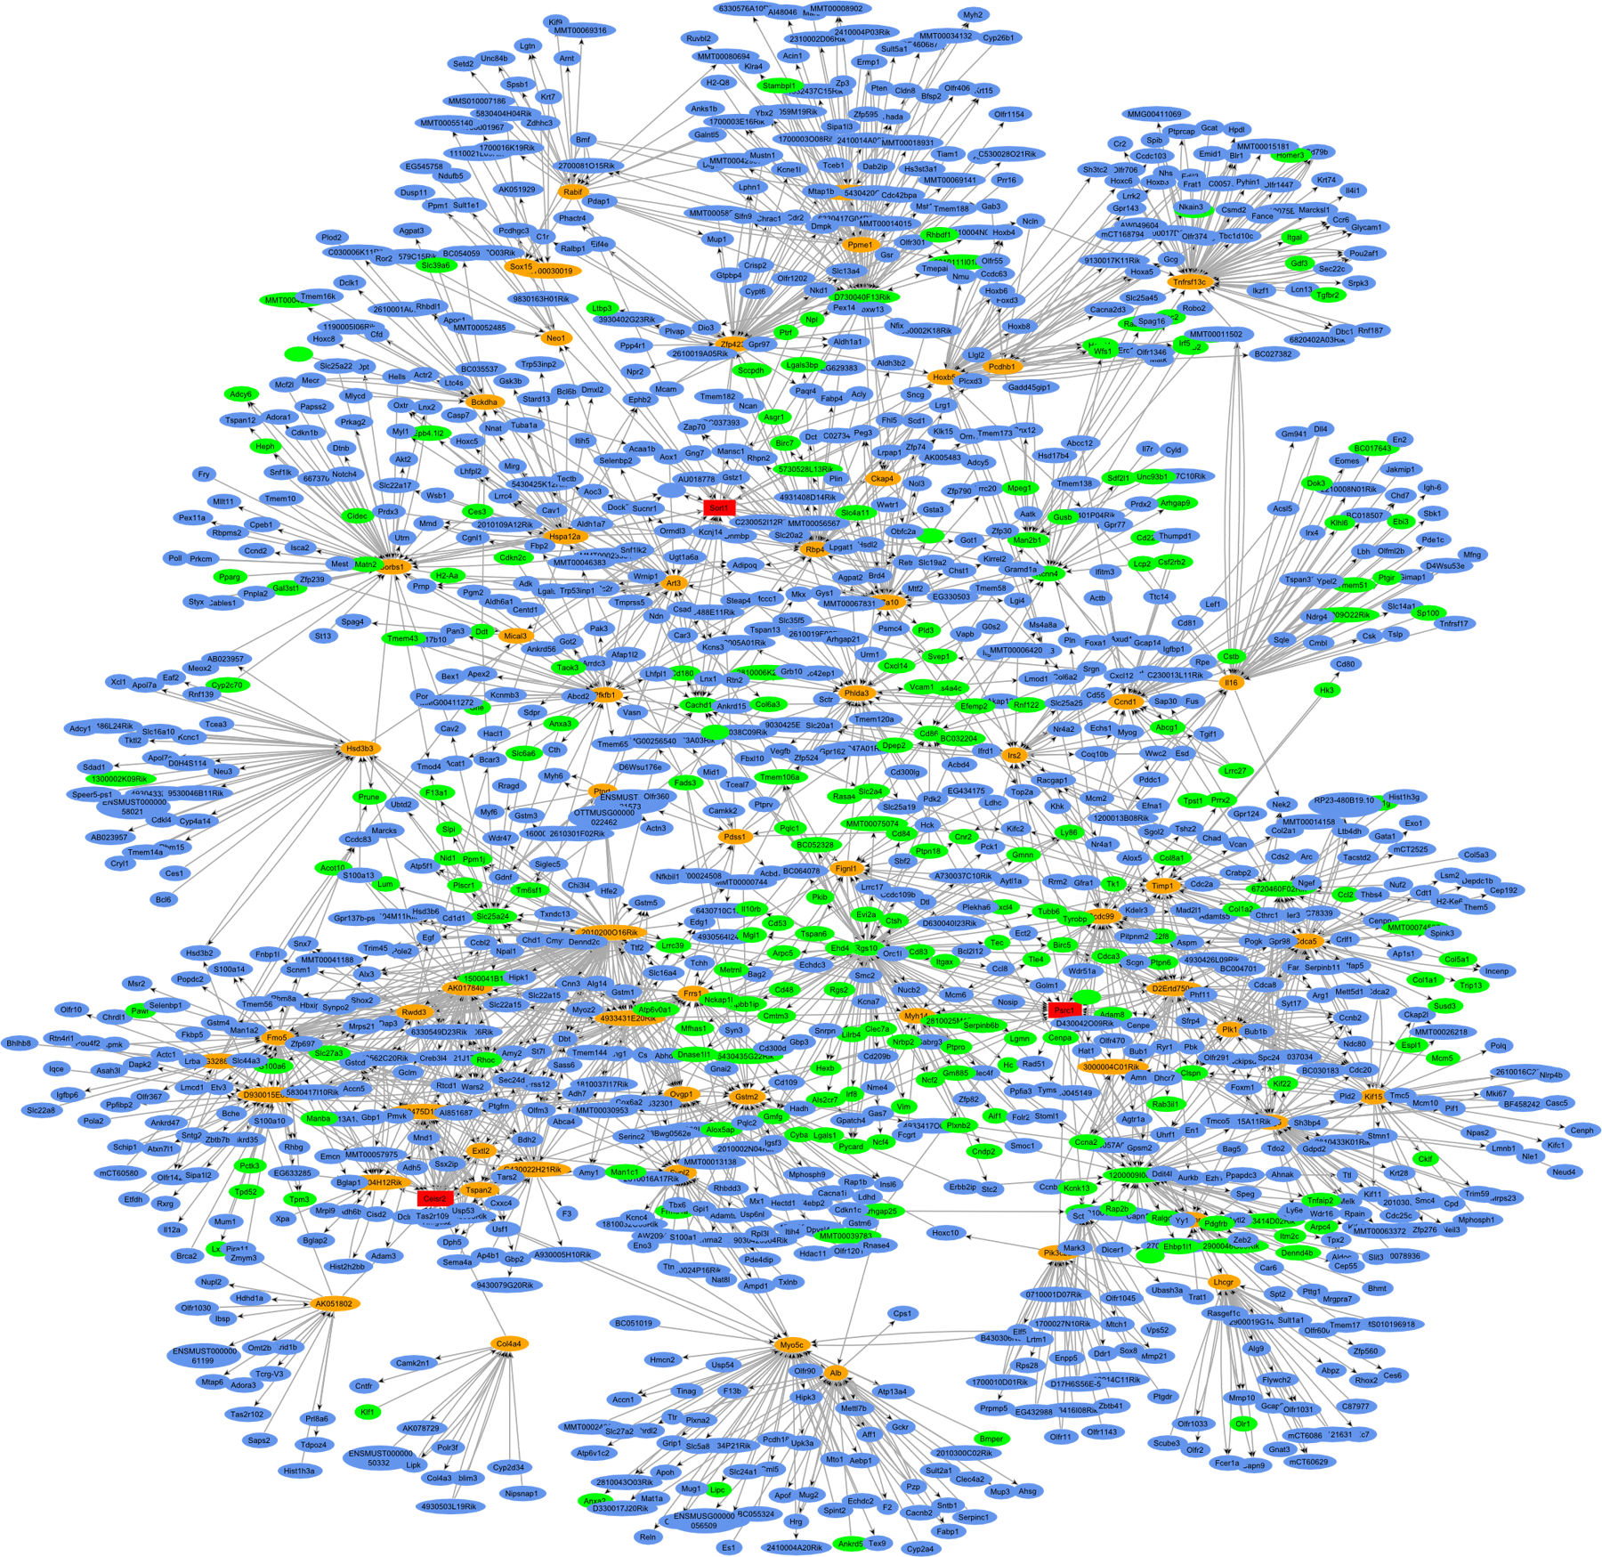
Pathway Mining and the Macrophage Enriched Module (MEM)
6
Genes function in 3D networks
Networks cluster into ‘modules’
Module-5 (the ‘macrophage enriched module’)
  contains 45-75% of the genes causal for atherosclerosis, obesity, diabetes, hypertension & inflammation (!)
  composed of only ~1300 genes
  dominated by inflammatory/immune genes (macrophage)
A unique & proprietary opportunity to mine targets this module
  that affect multiple diseases
  are unanticipated by conventional ‘candidate’ target strategies
6
1
500
1
500
500
11
1000
11
1000
1000
8
8
12
1500
12
1500
1500
14
14
10
10
4
4
2000
2000
2000
15
15
5
2500
5
2500
2500
13
13
17
3000
17
3000
3000
9
9
3
3500
3
3500
3500
2
4000
2
4000
4000
4500
4500
4500
16
16
18
18
7
5000
7
5000
5000
500
500
500
1000
1000
1000
1500
1500
1500
2000
2000
2000
2500
2500
2500
3000
3000
3000
3500
3500
3500
4000
4000
4000
4500
4500
4500
5000
5000
5000

Slide 24
New Target Identification: Sources
Pathway /
Network Analysis
Mouse
Genetics
Human
genetics
External Information / Licensing
Collaborations
GEMMs
RNAi
in vitro
in vivo

Slide 25



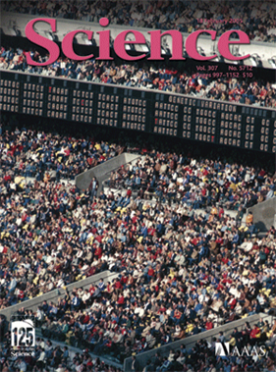



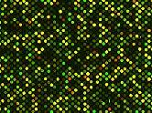


Ongoing Work: Comprehensively Map the Genetic Architecture of Expression in the Human Population
Assemble multiple cohorts from the human populations; collect tissue and DNA
Adipose Tissue
Liver
Genotype
Brain
Isolate DNA
Blood
Profile RNA
Atherosclerotic Lesions
Cancer Tissue

Slide 26
Use Internal Data to Prioritize Potential Targets from Publicly Available Genome Wide Association Study (GWAS) Data
Published SNP strongly associated with disease. Causal gene not evident
Raw public SNP data with weaker associations
Pathway information
Proprietary data (e.g. MegaX, networks)
Candidate causal genes and pathways of disease with human evidence
NEW TARGET

Slide 27
Target Validation

Slide 28
Approaches to Target Validation
Validation
of Candidate
Targets
License in KO
MCI and Deltagen
Systemic or CNS targeting
Germline RNAi
Sirna
Existing med chem compounds
Peptides/proteins
Exploratory chemistry / patent cmpds
mAbs against surface proteins
Academic
Biotech
KO
Viral vectors,
ASO, RNAi
Pharmacology
Antibodies
External
collaborations

Slide 29
New Target Validation
Pathway /
Network Analysis
Mouse
Genetics
Human
genetics
External Information / Licensing
Collaborations
GEMMs
RNAi
in vitro
in vivo

Slide 30


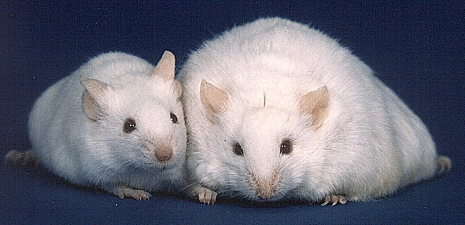
Target Validation: Genetically Engineered Mouse Models (GEMMS): Mouse as a Model
Rich biology & genetics
Comparative Genomics
Technology Toolbox
Feasibility & Practicality
Still it is a MODEL!

Slide 31
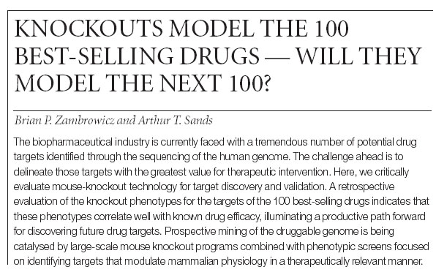
A Premise
Nature Reviews Drug Discovery 2, 38-51 (2003);

Slide 32
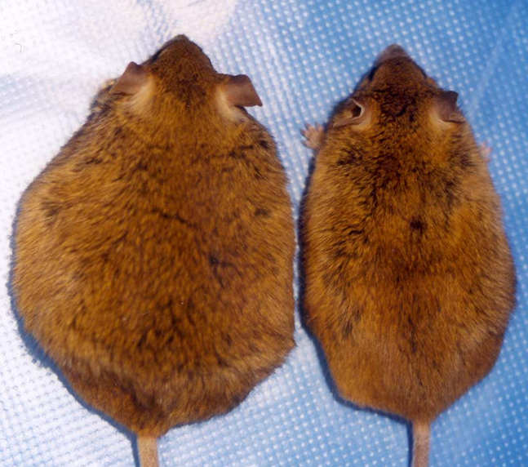

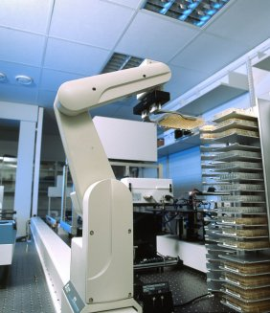
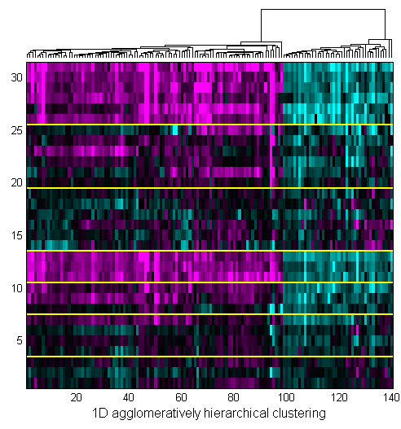
Target Validation: Genetically Engineered Mouse Models (GEMMs)
Candidate Targets
Literature
Genetics
Expression Profile
Pathway
…
Produce GEMM
?
Go/No Go for establishment of program and HTS
Phenotyping
Assess

Slide 33
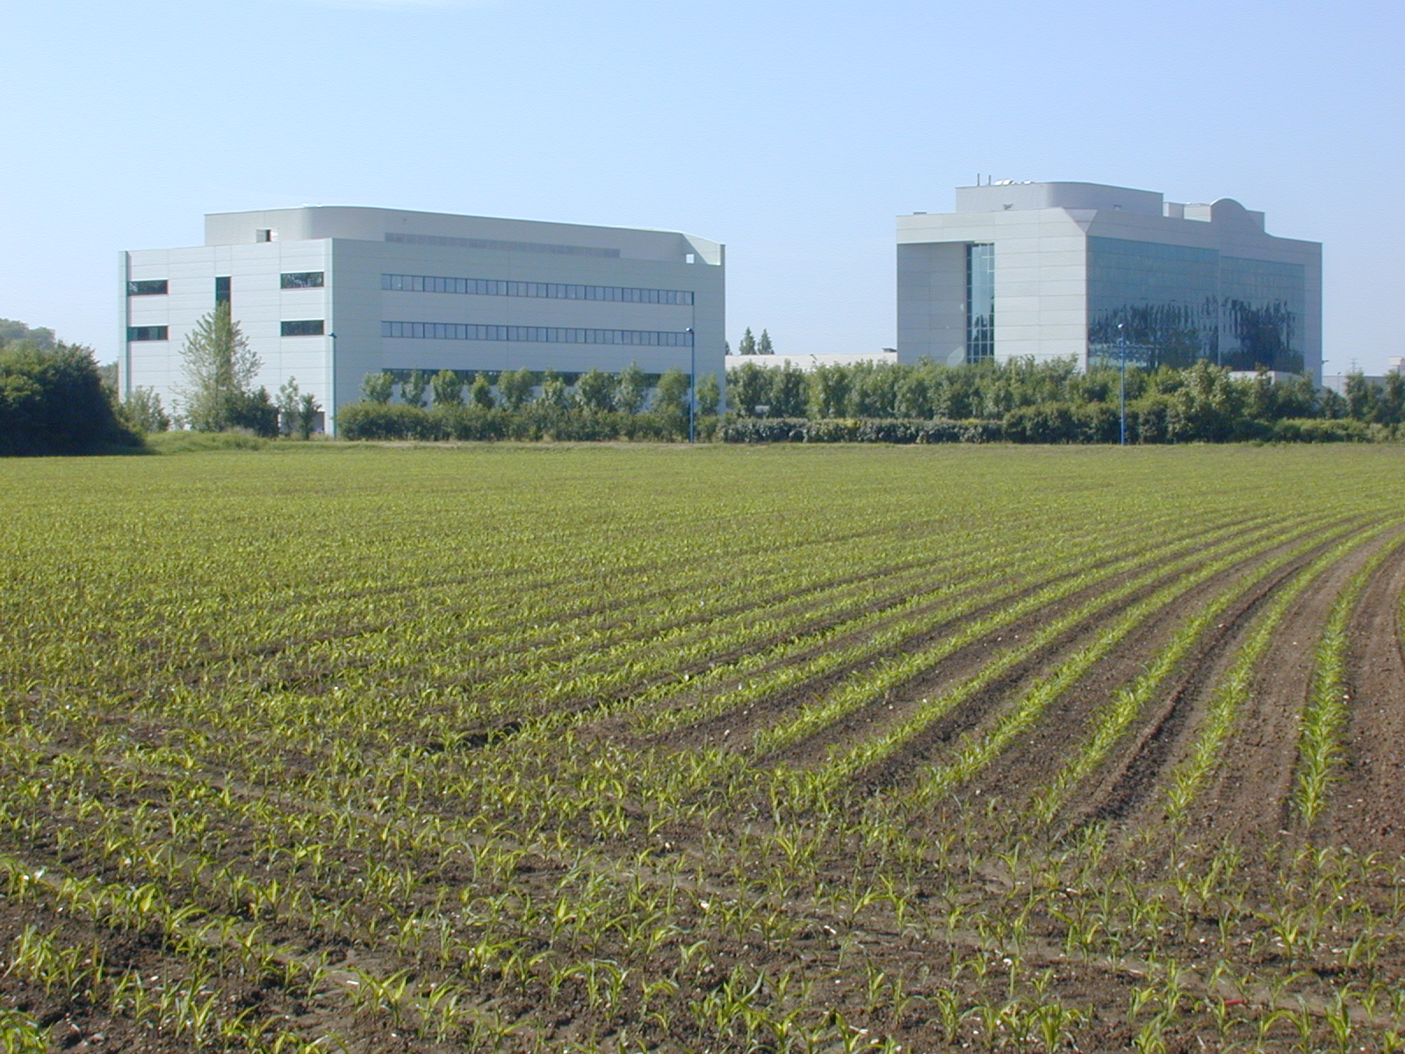
Mouse Clinical Institute (MCI) GEMM Production & Phenotyping
MCI’s Mission:
To provide a comprehensive array of services for the "mouse" scientific community. These activities span from the generation of new mouse models to phenotyping platforms.
Strasbourg France

Slide 34
New Target Identification: Sources
Pathway /
Network Analysis
Mouse
Genetics /
MegaX
Human
genetics
External Information / Licensing
Collaborations
MCI/cGEM
RNAi
in vitro
in vivo

Slide 35


Target Validation with Sirna
Merck’s commitment to RNA therapeutics
MERCK & CO., INC. ANNOUNCES COMPLETION OF ACQUISITION OF SIRNA THERAPEUTICS, INC.
29 December 2006
WHITEHOUSE STATION, N.J.(BUSINESS WIRE) Merck & Co., Inc. (NYSE: MRK ) today announced that it has successfully completed the acquisition of Sirna Therapeutics, Inc. (NASDAQ: RNAI ) in a cash transaction which closed in the fourth quarter of 2006.

Slide 36
RNA therapeutics as an emerging modality
RNAi as therapeutic (if fully realized)
  Single or multiple genes targeted per therapeutic candidate
  Potential to exploit targeting strategy for efficient & selective delivery
Potential to decrease timelines for preclinical and clinical POC
Ability to evaluate multiple genes in disease pathway(s) & network(s) and rationally define the drug product & selectivity profile
  Single v. multiple targets from single or multiple pathways & networks

Slide 37
Emerging Therapeutic Modalities
Increase target space
Sm Mol | Biologic | Oligonucleotide therapeutics
Proteome
druggable
Genome
druggable & non-druggable proteome
regulatory RNAs
Potential to expand the universe of targets to any gene in the genome

Slide 38
Novel Target Identification: Challenges
Long term investment is required
  Average timeline from candidate target ID to lead opt. is at least 2 years
  Low POS relative to targets with established biology.
  Resource intensive. Need “Quick kill” strategy.
Majority of new targets have no known molecular basis for phenotype
  Difficult to establish relevant pharmacodynamic assays
  Not clear where to target (intracellular, brain, etc.)
High false positive rate in RNAi screens

Slide 39
Target Identification and Validation: Summary
External targets will continue to be important to our pipeline, but much of the low hanging fruit is gone → identification of novel targets is critical to the long term health of the MRL pipeline
MRL is leveraging state-of-the art technologies for new target identification and validation
Strategic acquisitions of novel technologies have been critical to our ability to be competitive in this area
Future challenge is to refine tools and utilize external information to enable identification of targets with highest POS for entry into lead optimization

